Slide 1
CYYQ: Weather Assessment for Landing & Alternates
Nov 3, 2025
Alex Moore, First Officer
Calm Air

Slide 2
Purpose & Scope
Analysis for the evaluation of a proposed 2-alternate flight planning policy.
For each hour in the analysis period:
  Could we land in YYQ?
    METAR above landing minimums (visibility >= Ops Spec, ceiling > minimums)?
  Which 2 alternates were available?
    Used TAFs issued 3+ hours before arrival
    Forecast above alternate weather minimums (CAP GEN rules)
    Options: CYGX, CYTH, CYYL, CYNE, CYQD

Slide 3
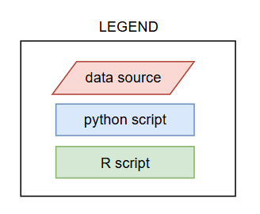
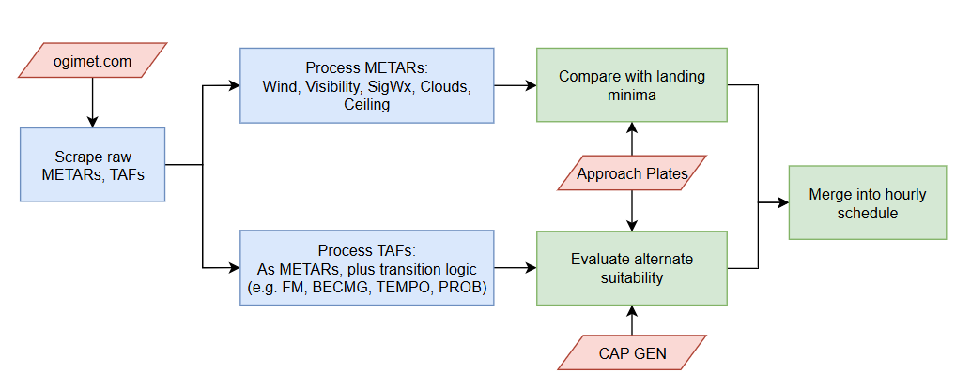
Methodology & Data Sources

Slide 4
Results: Jan-Oct 2025 (10 months, hourly)
YYQ METARs were suitable for landing 99% of the time
Fractional availability per alternate:
Distribution of number of simultaneously available alternates:
Aerodrome | CYGX | CYTH | CYYL | CYNE | CYQD
Available as alt | 88% | 96% | 93% | 85% | 93%
Number of alts | Count | frac
1 | 168 | 2%
2 | 490 | 7%
3 | 1,466 | 20%
4 | 2,157 | 30%
5 | 2,960 | 41%
2+ alternates available 98% of the time.

Slide 5
Sample Datasets
The following sample (preliminary) datasets have been provided:
Oct_2025_Processed_METARs.csv
  Hourly raw & processed METAR, with landing suitability analysis
Oct_2025_Processed_TAFs.csv
  Hourly raw & processed TAFs, with alternate suitability analysis
  Notation guide:
    A -> B indicates A BECMG B
    A (B) indicates A TEMPO B
    A [B] indicates A PROB B
Oct_2025_Alternate_Availability.csv
  Merged dataset

Slide 6
Further Work
Validate results & fix any bugs
Clean up code
Expand analysis period: 10+ years of data available
Scope refinement – what exactly do we want to investigate with this data?
Related analyses:
  Seasonality and alternate availability
  Statistical tables for crosswinds to inform training standards
  Expanding scope to YRT sked & Freighter ops

